Slide 1

7.5
Work
Copyright © Cengage Learning. All rights reserved.

Slide 2
Objectives
Find the work done by a constant force.
Find the work done by a variable force.

Slide 3
Work Done by a Constant Force

Slide 4
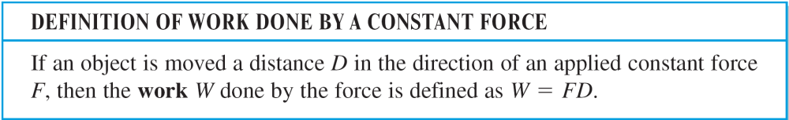
Work Done by a Constant Force
In general, work is done by a force when it moves an object. If the force applied to the object is constant, then the definition of work is as follows.

Slide 5
Work Done by a Constant Force
There are many types of forces—centrifugal, electromotive, and gravitational, to name a few.
A force can be thought of as a push or a pull; a force changes the state of rest or state of motion of a body.
For gravitational forces on Earth, it is common to use units of measure corresponding to the weight of an object.

Slide 6
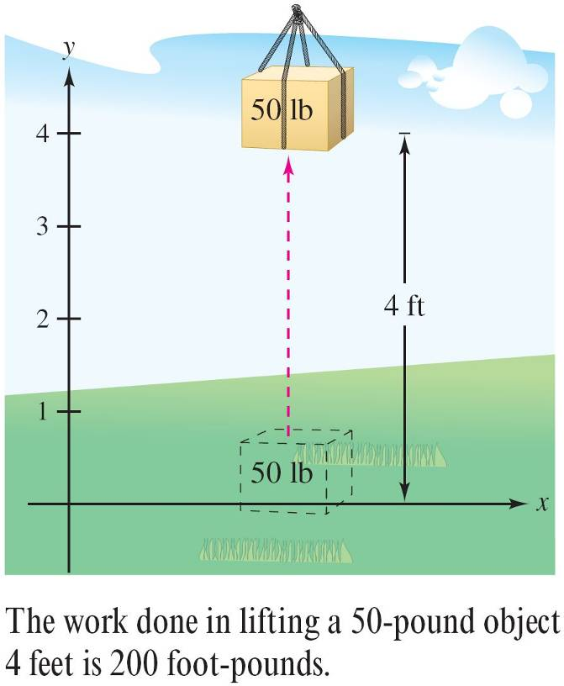

Example 1 – Lifting an Object
Determine the work done in lifting a 50-pound object 4 feet.
Solution:
The magnitude of the
required force F is the weight of
the object, as shown in
Figure 7.48.
So, the work done in
lifting the object 4 feet is
W = FD
= 50(4)
= 200 foot-pounds
Figure 7.48

Slide 7
Work Done by a Constant Force
In the U.S. measurement system, work is typically expressed in foot-pounds (ft-lb), inch-pounds, or foot-tons.
In the centimeter-gram-second (C-G-S) system, the basic unit of force is the dyne—the force required to produce an acceleration of 1 centimeter per second on a mass of 1 gram.
In this system, work is typically expressed in dyne-centimeters (ergs) or newton-meters (joules), where 1 joule = 10⁷ ergs.

Slide 8
Work Done by a Variable Force

Slide 9
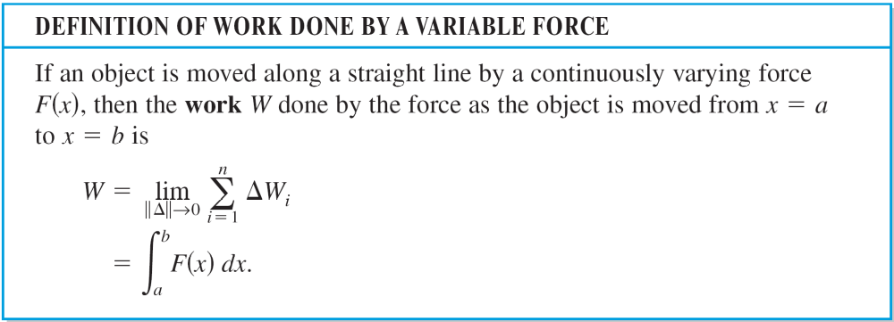
Work Done by a Variable Force

Slide 10
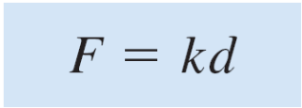
Work Done by a Variable Force
The following three laws of physics were developed by Robert Hooke (1635–1703), Isaac Newton (1642–1727), and Charles Coulomb (1736 –1806).
Hooke’s Law: The force F required to compress or stretch a spring (within its elastic limits) is proportional to the distance d that the spring is compressed or stretched from its original length. That is,
where the constant of proportionality k (the spring constant) depends on the specific nature of the spring.

Slide 11
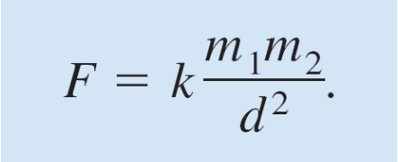
Work Done by a Variable Force
2. Newton’s Law of Universal Gravitation: The force F of attraction between two particles of masses m₁ and m₂ is proportional to the product of the masses and inversely proportional to the square of the distance d between the two particles. That is,
If m₁ and m₂ are given in grams and d in centimeters, F will be in dynes for a value of k = 6.670 × 10^{–8} cubic centimeter per gram-second squared.

Slide 12
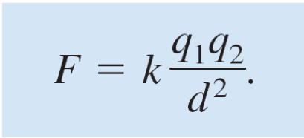
Work Done by a Variable Force
3. Coulomb’s Law: The force F between two charges
q₁ and q₂ in a vacuum is proportional to the product of the charges and inversely proportional to the square of the distance d between the two charges. That is,
If q₁ and q₂ are given in electrostatic units and d in centimeters, F will be in dynes for a value of k = 1.

Slide 13
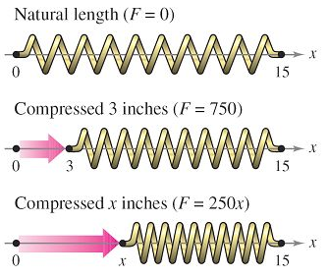
Example 2 – Compressing a Spring
A force of 750 pounds compresses a spring 3 inches from its natural length of 15 inches. Find the work done in compressing the spring an additional 3 inches.
Solution:
By Hooke’s Law, the force F(x) required to compress the spring x units (from its natural length) is F(x) = kx.
Using the given data, it follows that
F(3) = 750 = (k)(3) and
so k = 250 and F(x) = 250x,
as shown in Figure 7.50.
Figure 7.50

Slide 14
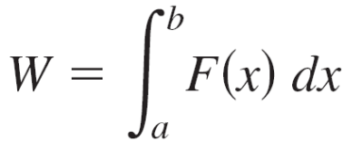
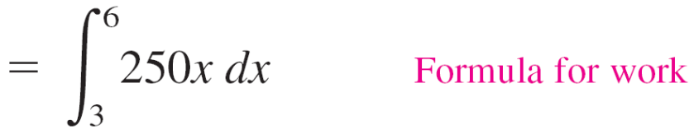
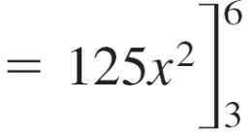


Example 2 – Solution
cont’d
To find the increment of work, assume that the force required to compress the spring over a small increment Δx is nearly constant.
So, the increment of work is ΔW = (force) (distance increment) = (250x) Δx.
Because the spring is compressed from x = 3 to x = 6 inches less than its natural length, the work required is

Slide 15
Example 2 – Solution
cont’d
Note that you do not integrate from x = 0 to x = 6 because you were asked to determine the work done in compressing the spring an additional 3 inches (not including the first 3 inches).

Slide 16
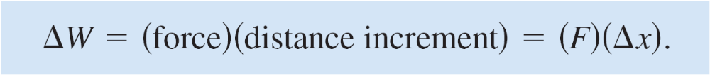
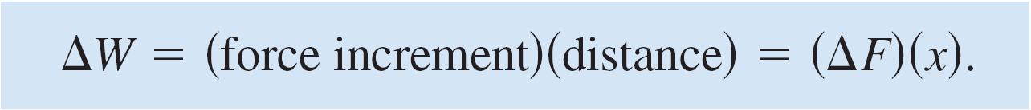
Work Done by a Variable Force
Another way to formulate the increment of work is
This second interpretation of ΔW is useful in problems involving the movement of nonrigid substances such as fluids and chains.

Slide 17
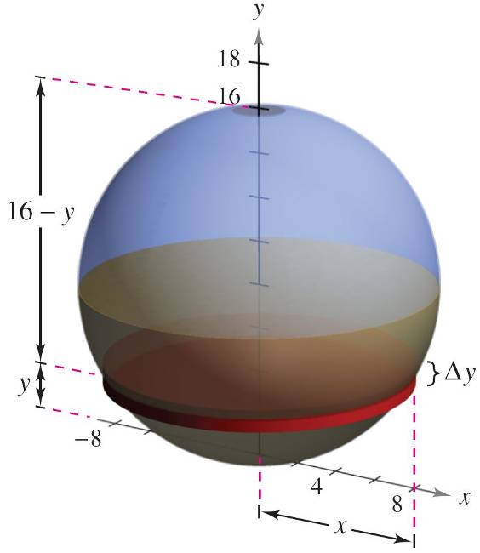
Example 4 – Emptying a Tank of Oil
A spherical tank of radius 8 feet is half full of oil that weighs 50 pounds per cubic foot. Find the work required to pump oil out through a hole in the top of the tank.
Solution:
Consider the oil to be
subdivided into disks of
thickness Δy and radius x,
as shown in Figure 7.52.
Figure 7.52

Slide 18

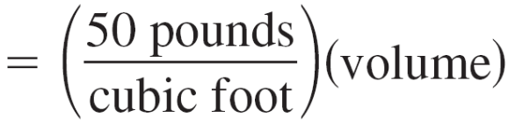

Example 4 – Solution
cont’d
Because the increment of force for each disk is given by its
weight, you have
For a circle of radius 8 and center at (0, 8), you have
x² + (y – 8)² = 8²
x² = 16y – y²
and you can write the force increment as
ΔF = 50(πx²Δy)
= 50π(16y – y²)Δy.

Slide 19
Example 4 – Solution
cont’d
In Figure 7.52, note that a disk y feet from the bottom of the tank must be moved a distance of (16 – y) feet.
So, the increment of work is
ΔW = ΔF(16 – y)
= 50π(16y – y²)Δy(16 – y)
= 50π(256y – 32y² + y³)Δy.
Figure 7.52

Slide 20
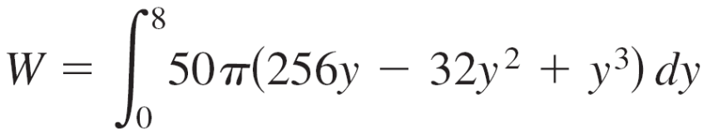
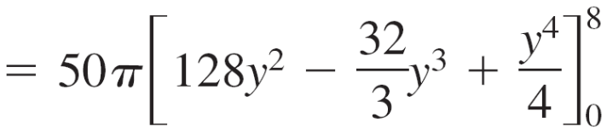
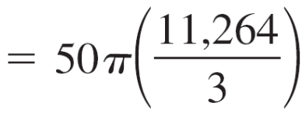

Example 4 – Solution
cont’d
Because the tank is half full, y ranges from 0 to 8, and
the work required to empty the tank is

